Slide 1
Data Pirates Superstore🏴‍☠️
Akshat - 016800121
Ashritha - 016798860
Dhurmil - 016781934
Maulik - 016804086

Slide 2
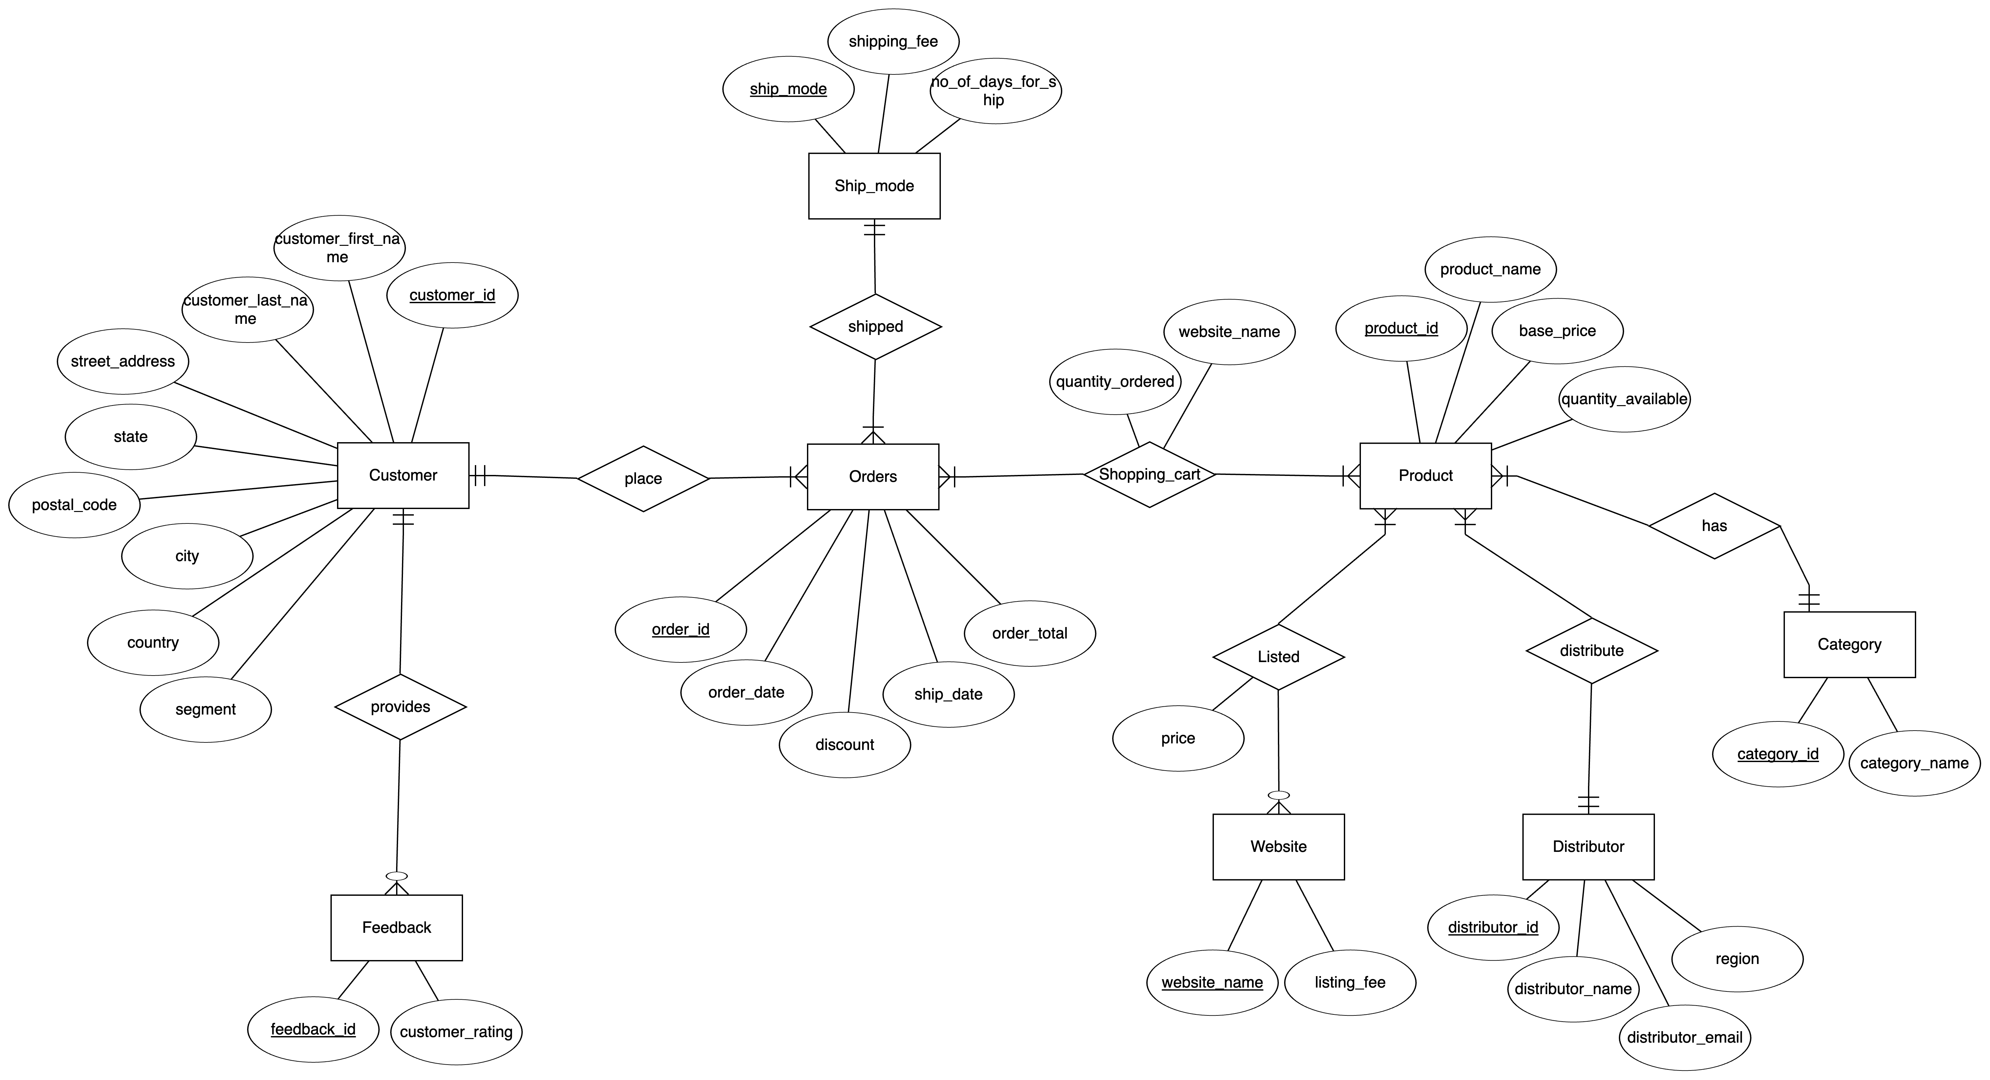
ER Diagram

Slide 3
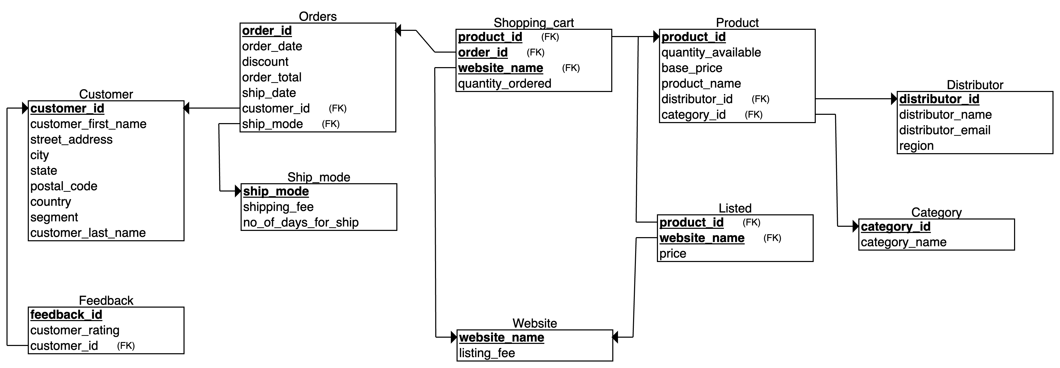
Relational Schema

Slide 4
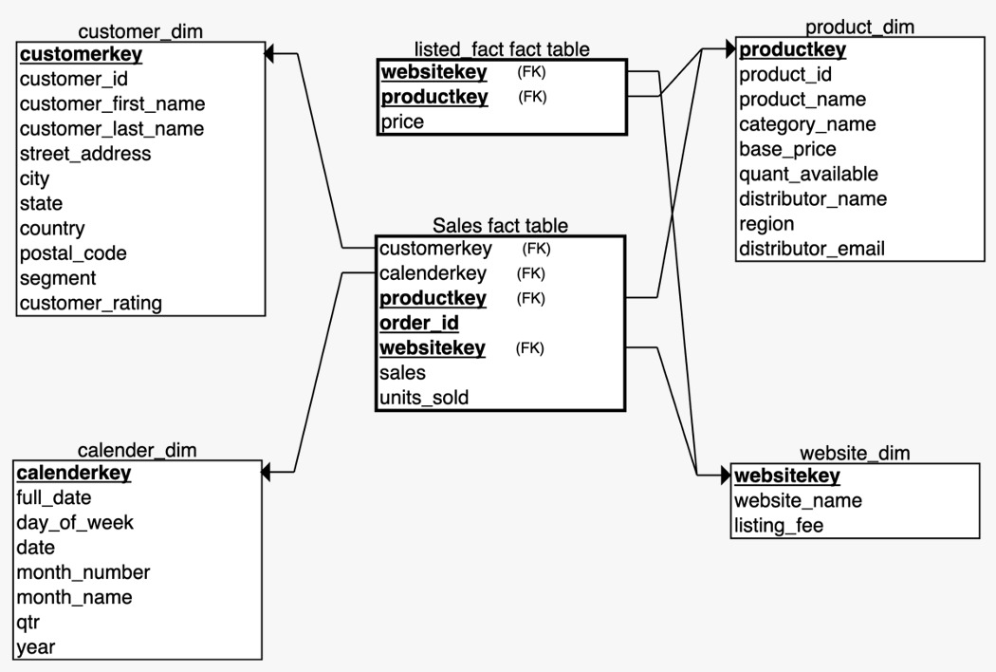
Star Schema

Slide 5
Operational Database Demo

Slide 6
Analytical Database Demo

Slide 7
Thank You😀

